Slide 1
CAD System for Lung Diseases
M1 Project Progress Presentation

Slide 2
PROJECT DELIVERABLES
Research paper.
Fully functional CAD system.

Slide 3
Problem Statement Overview
ILD are a group of over 200 lung conditions.
Most ILD are idiopathic in nature.
Progressive symptoms with no cure.
Nature of diffuse is uncertain.

Slide 4
HOW DO DOCTORS DIAGNOSE ILD
Doctor identifies ILD patterns in the CT scan
Doctor diagnoses the patient based on the his experience
FVC of the patient is measured for weeks
CT scan of lungs is done if FVC deteriorates

Slide 5
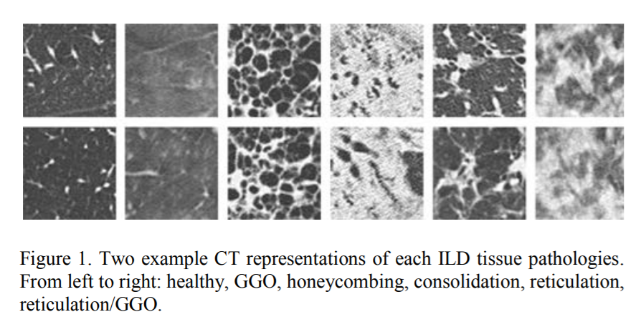
WHAT PATTERNS?

Slide 6
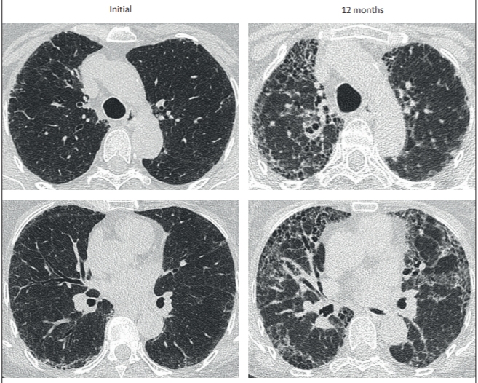
WHAT PATTERNS?

Slide 7
Problem Statement Overview
ILD are a group of over 200 lung conditions.
Most ILD are idiopathic in nature.
Progressive symptoms with no cure.
Nature of diffuse is uncertain.

Slide 8
GANTT CHART

Slide 9
REFERENCE
KAGGLE OSIC Competition.
University of Cornell’s Holistic Interstitial Lung Disease Detection using Deep CNN: Multi-Label Learning and Unordered Pooling.
Deep Convolution Neural Networks for CAD: CNN Architectures, Dataset Characteristics and Transfer Learning

